Slide 1
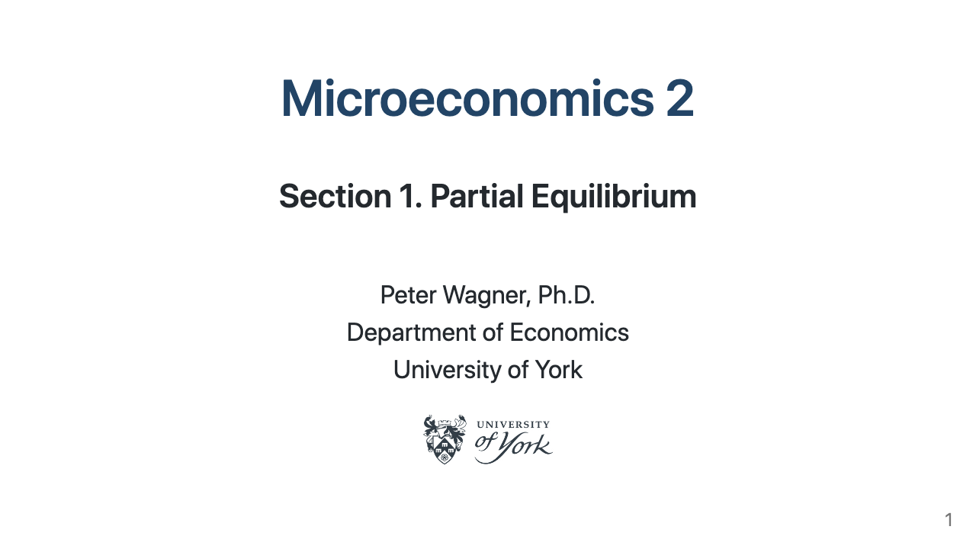

Slide 2
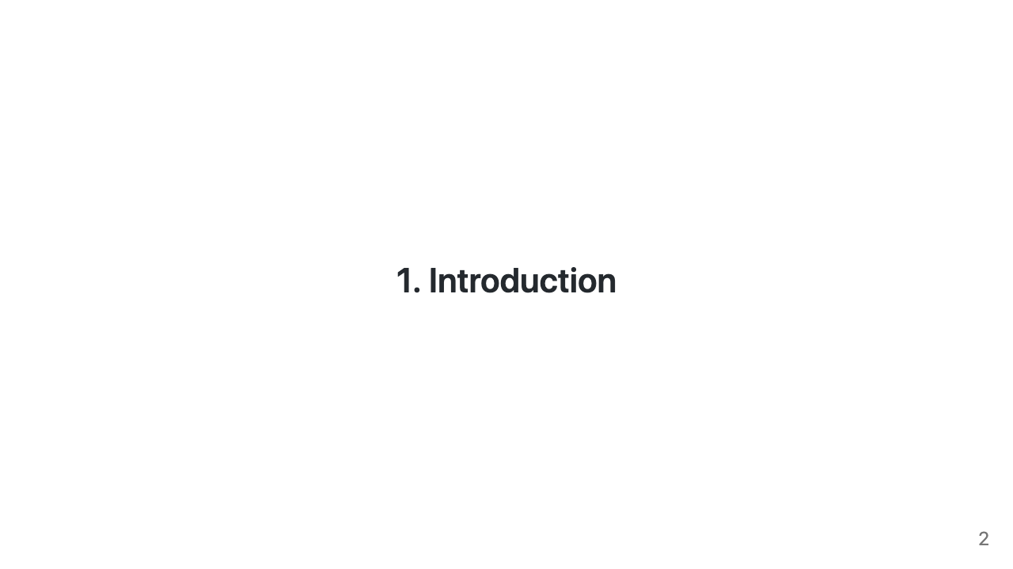

Slide 3
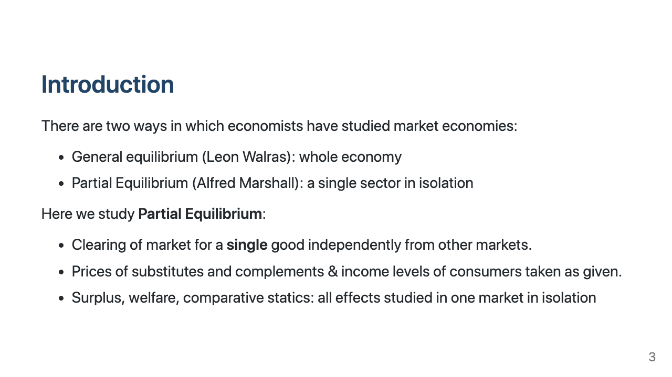
Notes:
# Learning Objectives - Understand the difference between General and Partial Equilibrium - Construct demand and supply functions in a Partial Equilibrium model - Understand basic properties of demand and supply and their meaning - Understand measures of market performance: surplus, welfare, efficiency - Implications of different modes of competition on market performance?

Slide 4
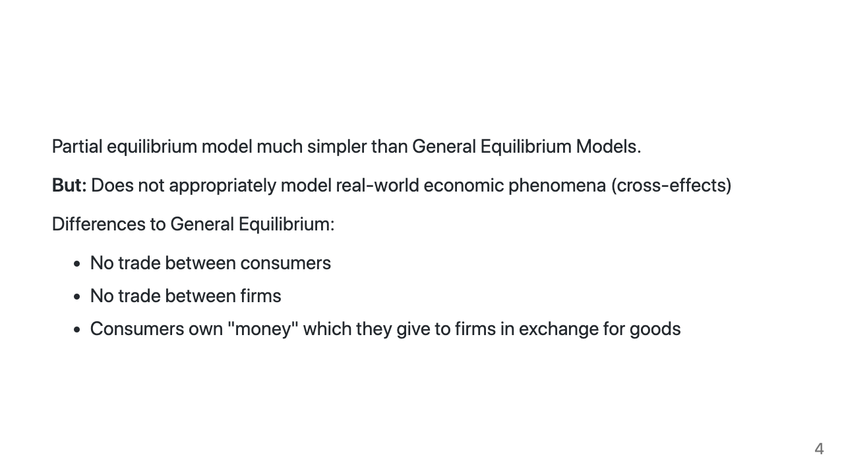

Slide 5
